Slide 1








This presentation uses the Pretendard and D2Coding font. Photo by Rubaitul Azad on Unsplash
.NET Conf 2024 x Seoul
Empowering Tomorrow - Full Stack, AI Enhanced, Developer Focused
Presented by

Slide 2

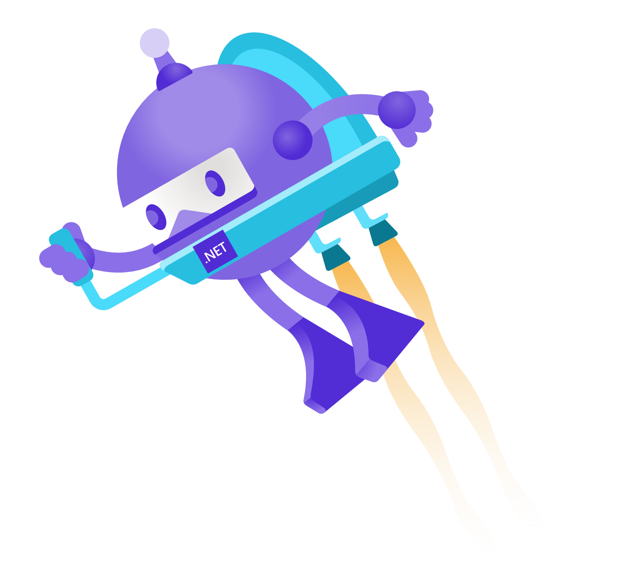
데이터 마술사: LINQ 의 친구 Reactive Extensions!
이상준
Presented by

Slide 3
Single Column Slide

Slide 4
Dual Column Slide

Slide 5
Demonstration
Summary

Slide 6
Sample Code
// Write the sample code here
Console.WriteLine(“Hello, World!”);

Slide 7
Announcement
Topic 1
Topic 2
Topic 3

Slide 8
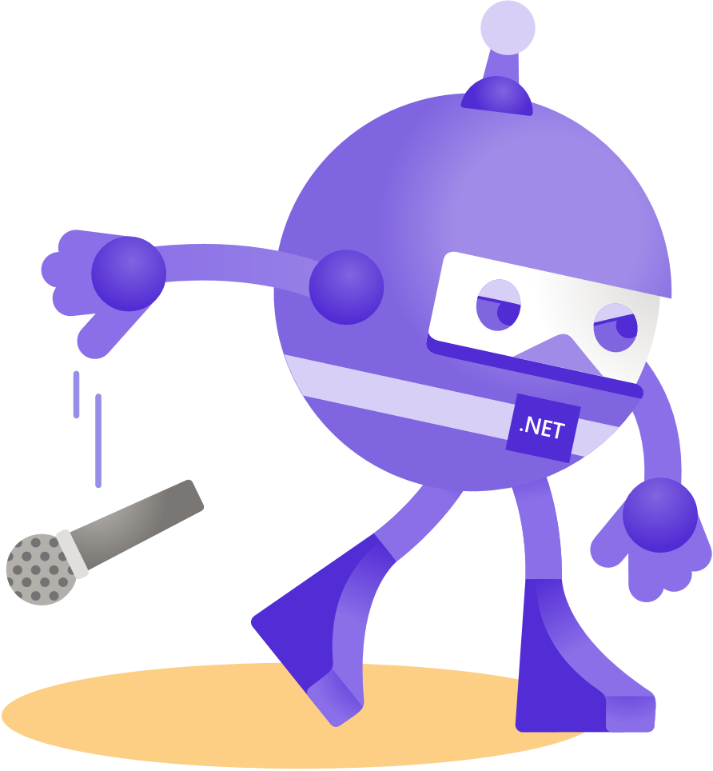
Thank you!
Presented by

Slide 9


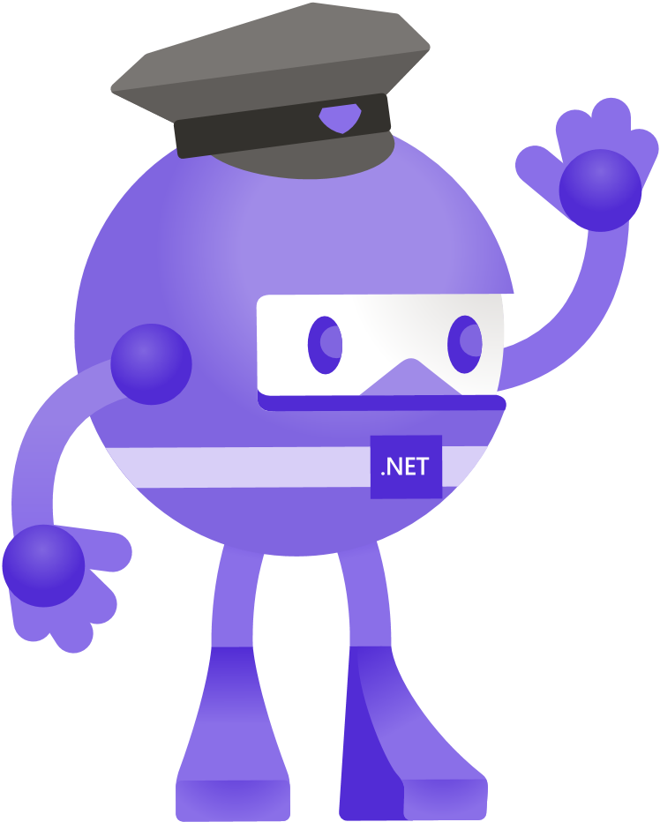



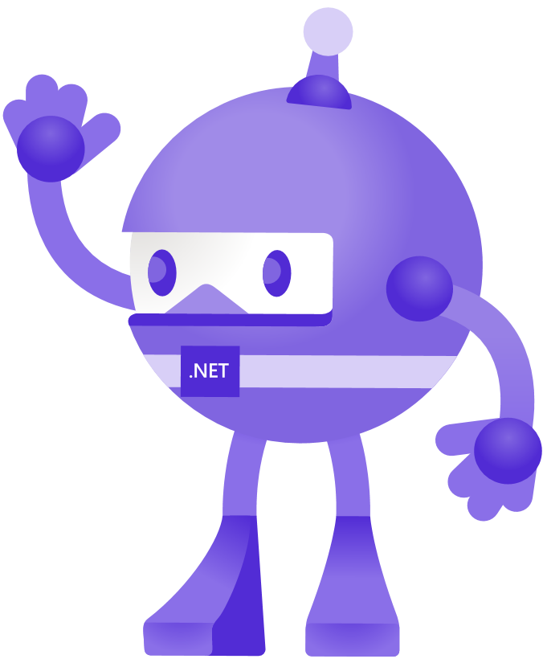


Slide 10
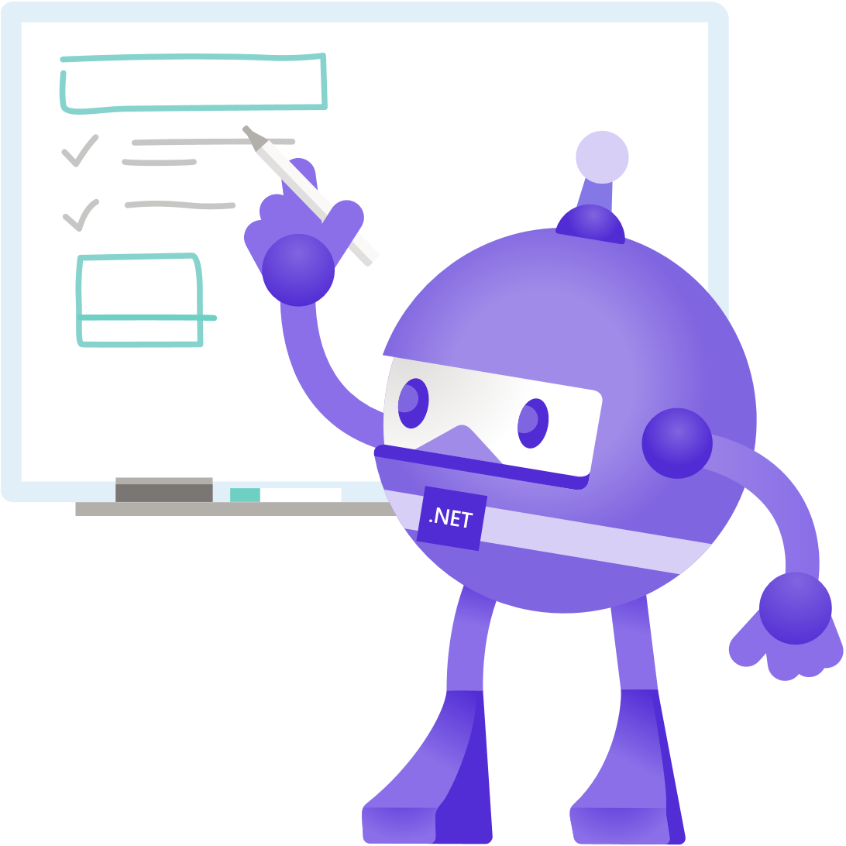



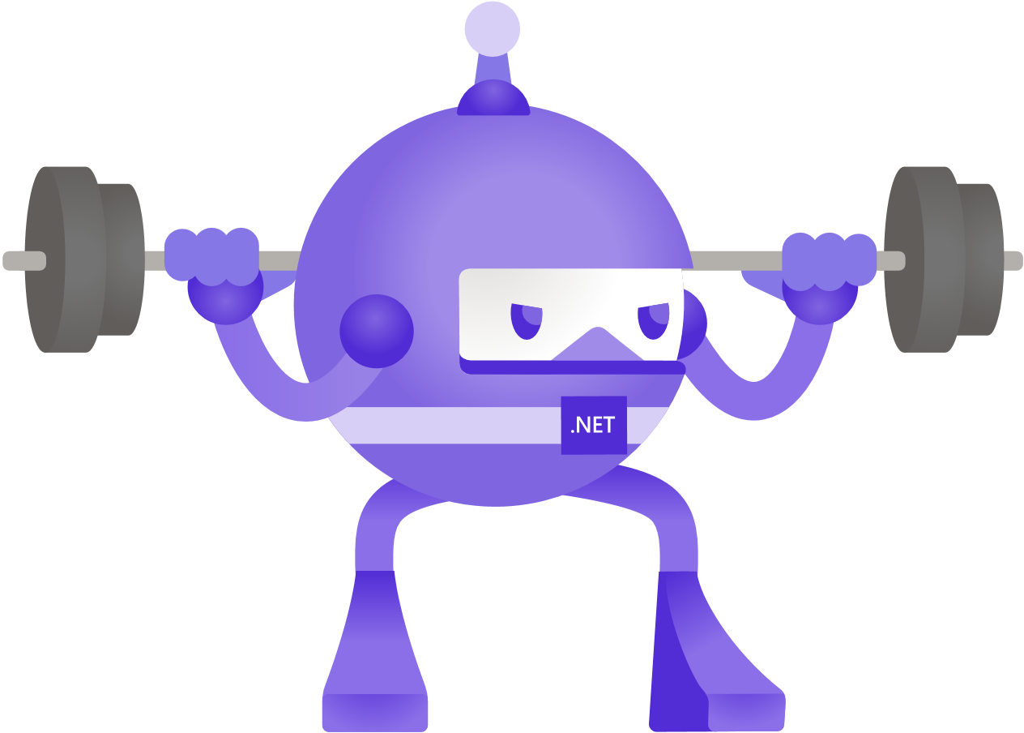
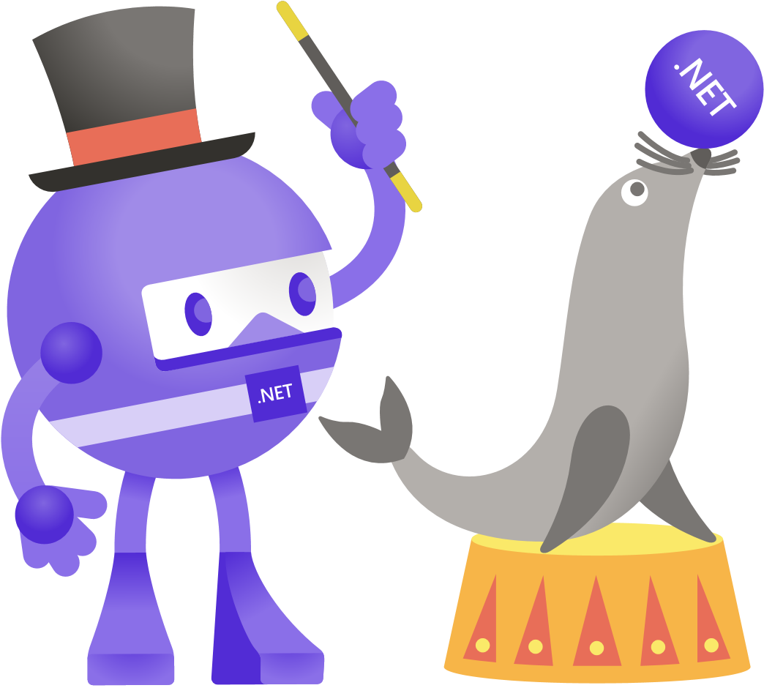
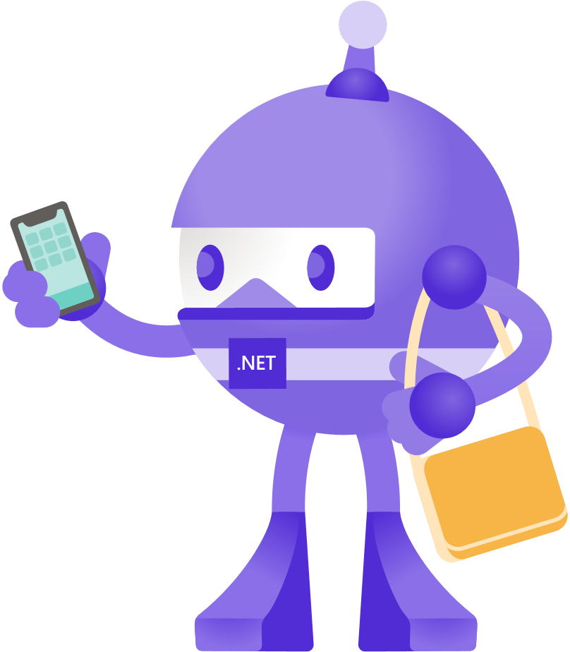

Slide 11


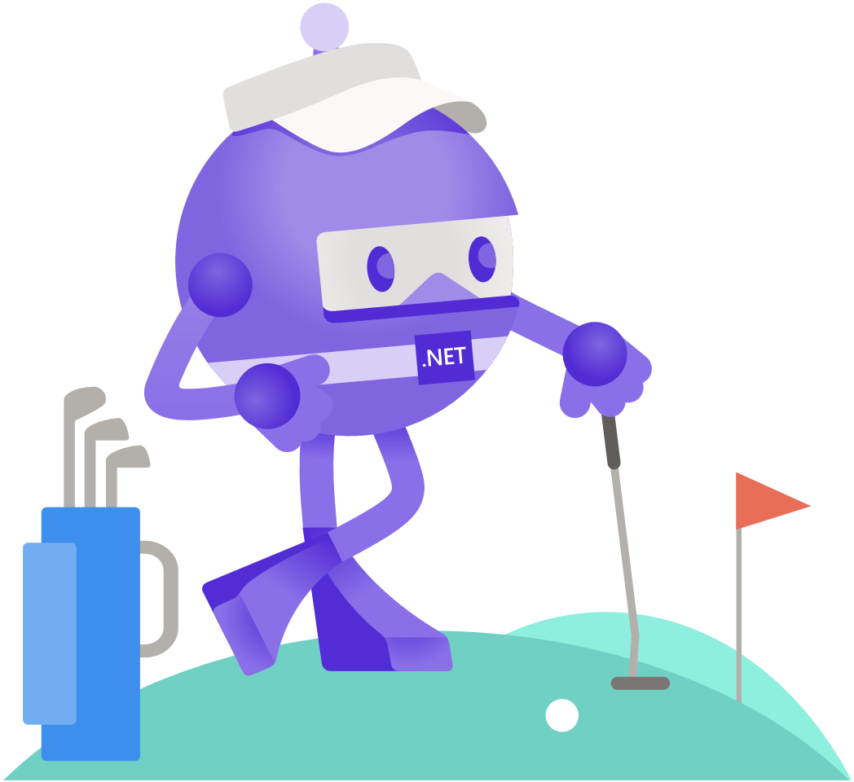


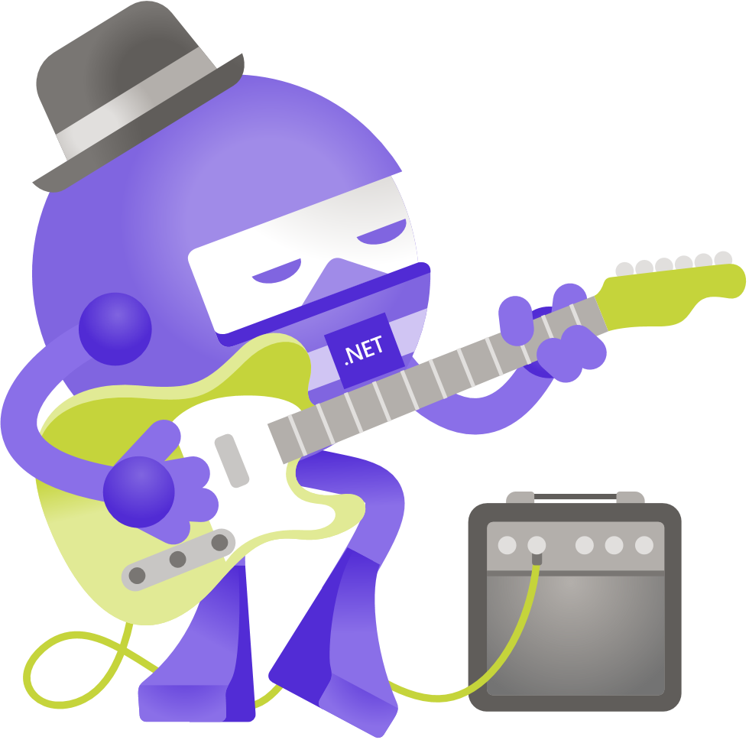
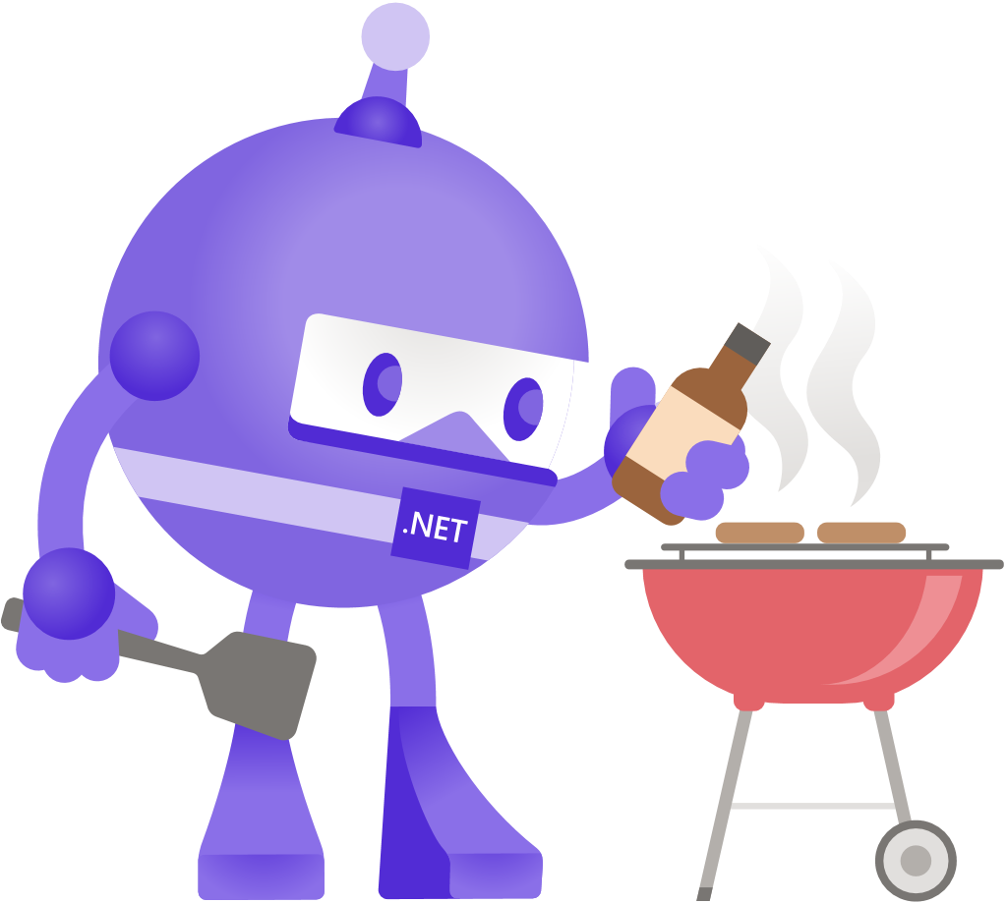

Slide 12


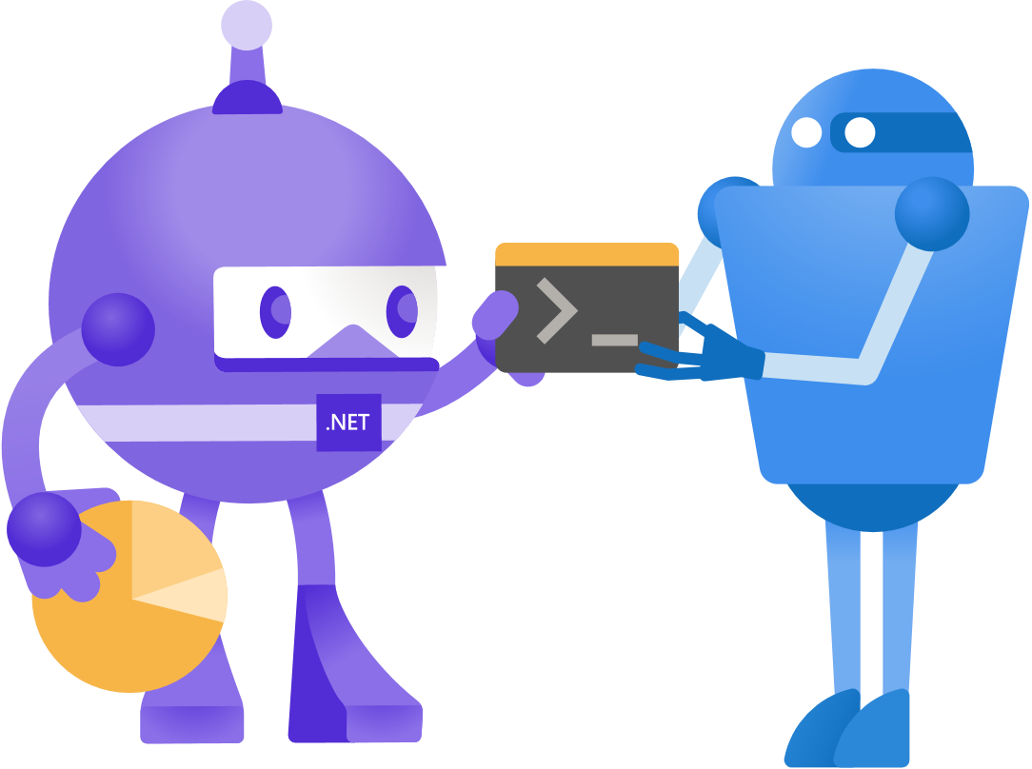

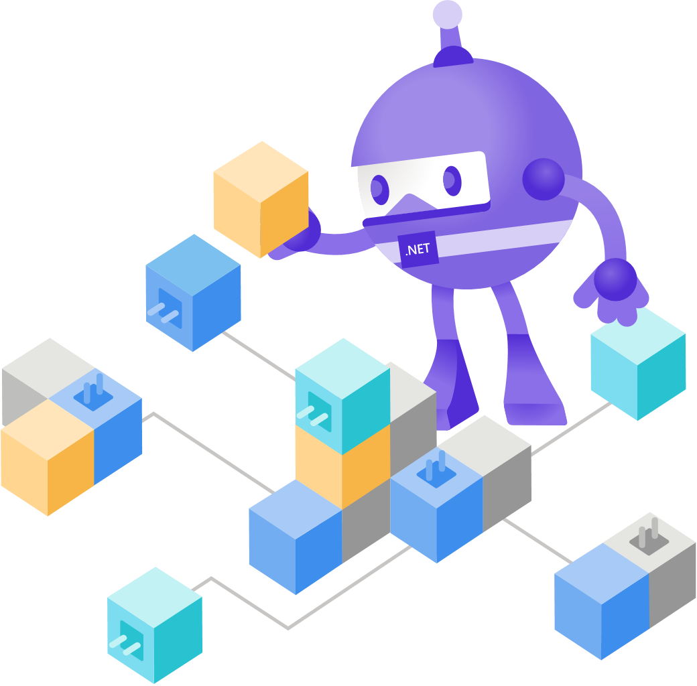
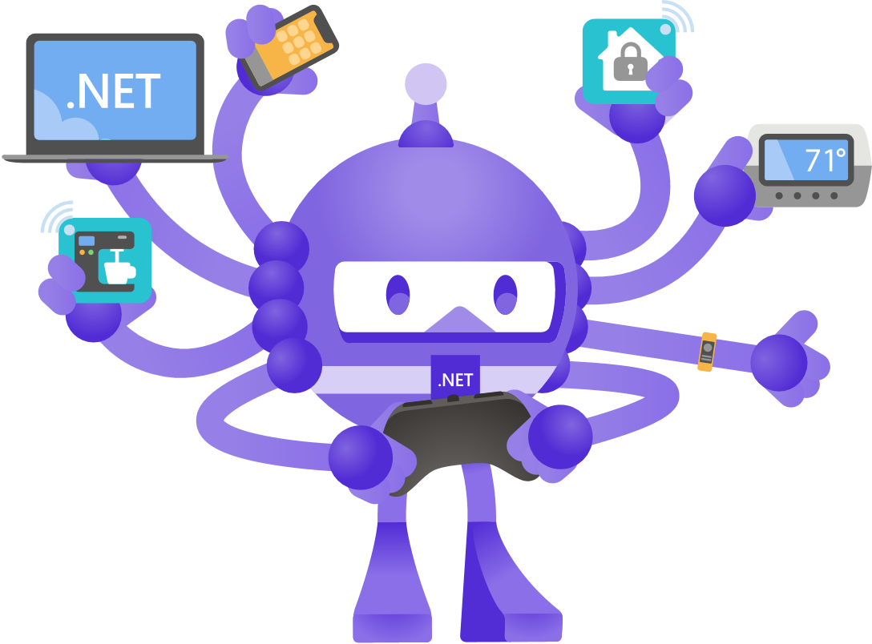

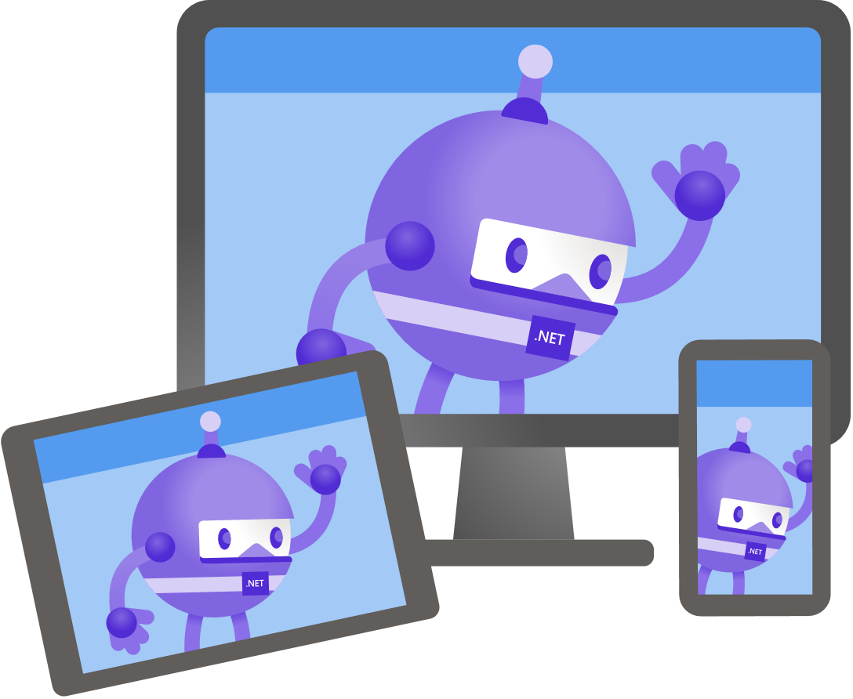

Slide 13
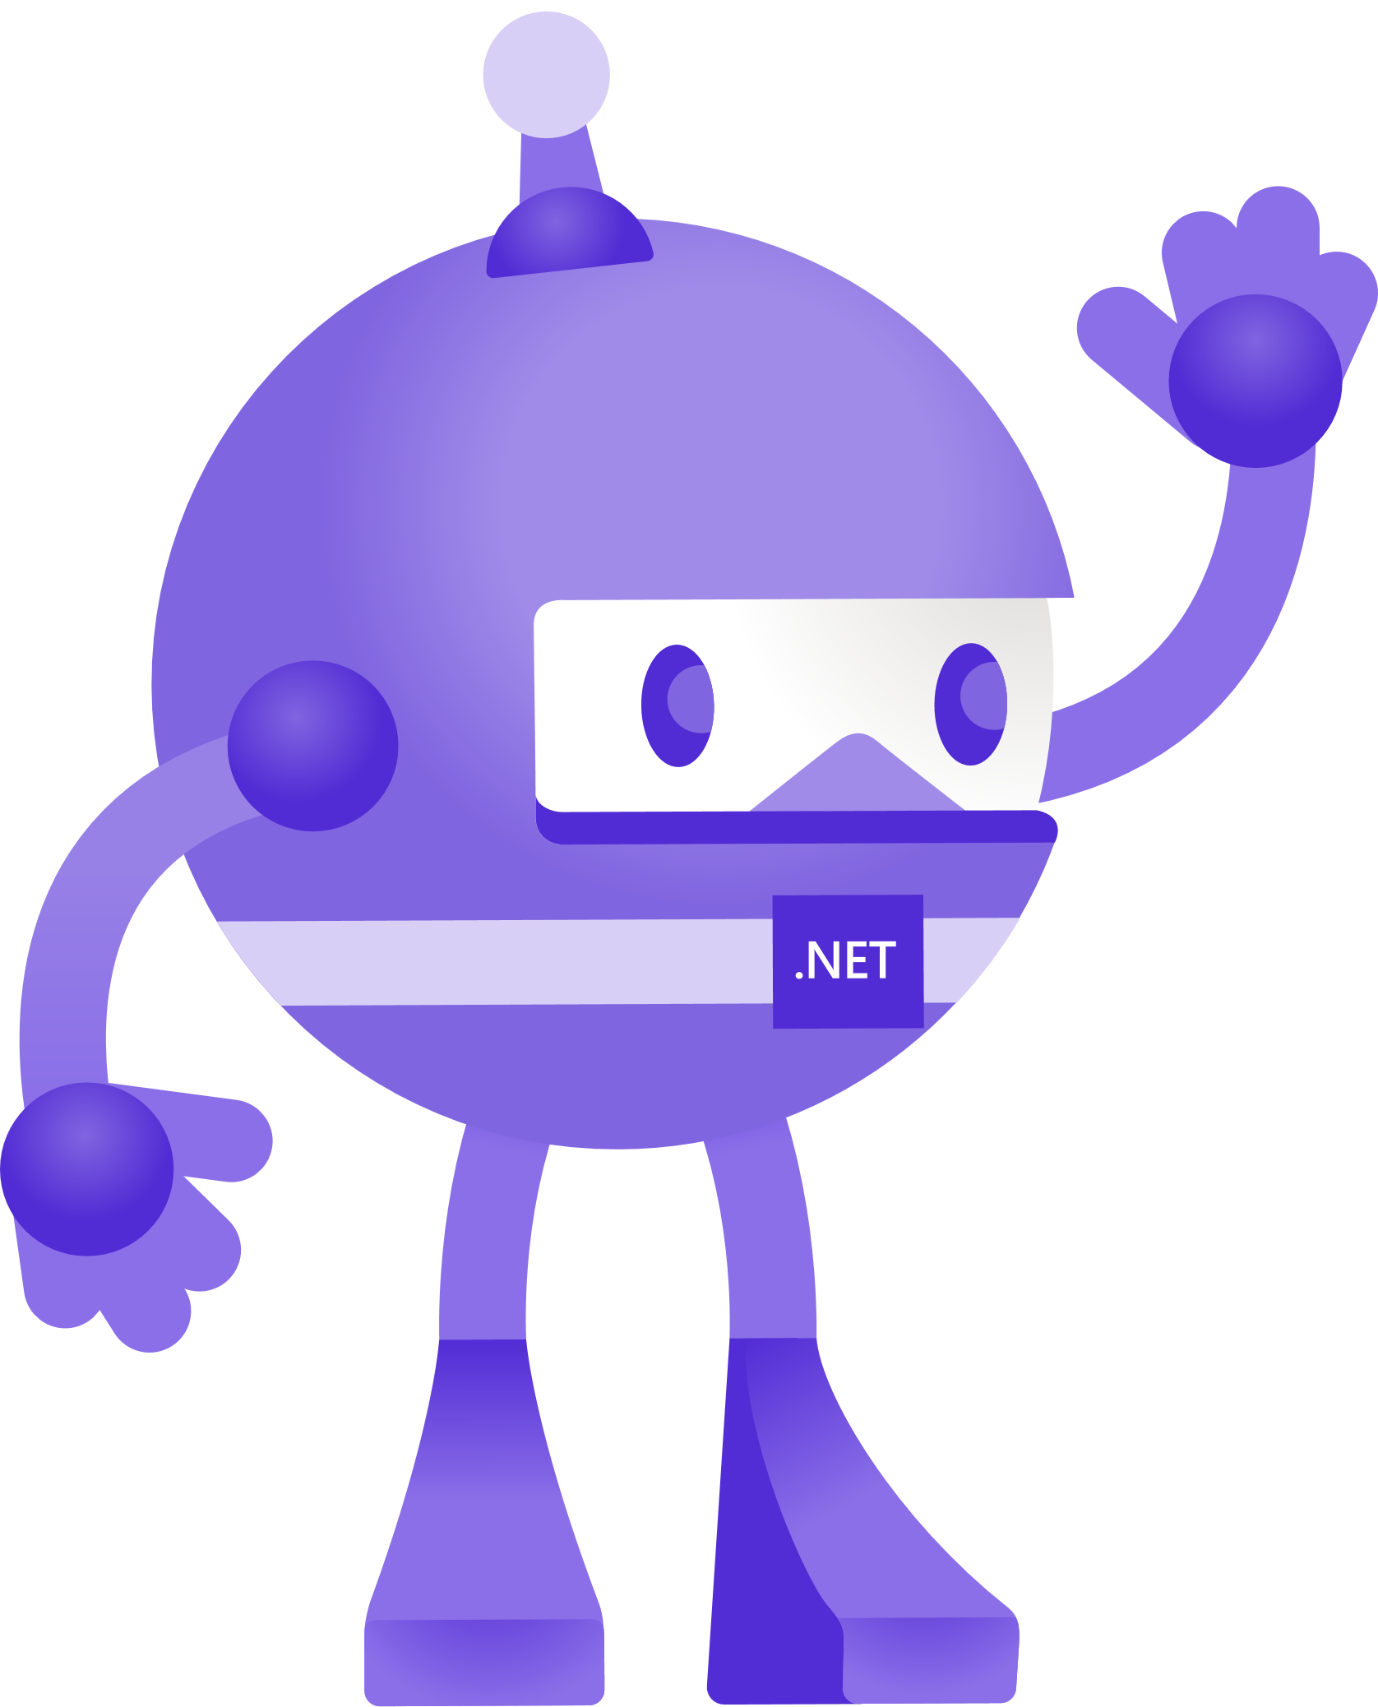




Slide 14


Slide 15


Slide 16


Slide 17


Slide 18


